Slide 1


Tech ABC Corp - HR Database
[Neidy Tunzine October 2024]

Slide 2
Business Scenario
Business requirement
Tech ABC Corp saw explosive growth with a sudden appearance onto the gaming scene with their new AI-powered video game console. As a result, they have gone from a small 10 person operation to 200 employees and 5 locations in under a year. HR is having trouble keeping up with the growth, since they are still maintaining employee information in a spreadsheet. While that worked for ten employees, it has becoming increasingly cumbersome to manage as the company expands.
As such, the HR department has tasked you, as the new data architect, to design and build a database capable of managing their employee information.
Dataset
The HR dataset you will be working with is an Excel workbook which consists of 206 records, with eleven columns. The data is in human readable format, and has not been normalized at all. The data lists the names of employees at Tech ABC Corp as well as information such as job title, department, manager's name, hire date, start date, end date, work location, and salary.
IT Department Best Practices
The IT Department has certain Best Practices policies for databases you should follow, as detailed in the Best Practices document.

Slide 3
Step 1
Data Architecture Foundations

Slide 4
Step 1: Data Architecture Foundations
Hi,
Welcome to Tech ABC Corp. We are excited to have some new talent onboard. As you may already know, Tech ABC Corp has recently experienced a lot of growth. Our AI powered video game console WOPR has been hugely successful and as a result, our company has grown from 10 employees to 200 in only 6 months (and we are projecting a 20% growth a year for the next 5 years). We have also grown from our Dallas, Texas office, to 4 other locations nationwide: New York City, NY, San Francisco, CA, Minneapolis, MN, and Nashville, TN.
While this growth is great, it is really starting to put a strain on our record keeping in HR. We currently maintain all employee information on a shared spreadsheet. When HR consisted of only myself, managing everyone on an Excel spreadsheet was simple, but now that it is a shared document I am having serious reservations about data integrity and data security. If the wrong person got their hands on the HR file, they would see the salaries of every employee in the company, all the way up to the president.
After speaking with Jacob Lauber, the manager of IT, he suggested I put in a request to have my HR Excel file converted into a database. He suggested I reach out to you as I am told you have experience in designing and building databases. When you are building this, please keep in mind that I want any employee with a domain login to be have read only access the database. I just don't want them having access to salary information. That needs to be restricted to HR and management level employees only. Management and HR employees should also be the only ones with write access. By our current estimates, 90% of users will be read only.
I also want to make sure you know that am looking to turn my spreadsheet into a live database, one I can input and edit information into. I am not really concerned with reporting capabilities at the moment. Since we are working with employee data we are required by federal regulations to maintain this data for at least 7 years; additionally, since this is considered business critical data, we need to make sure it gets backed up properly.
As a final consideration. We would like to be able to connect with the payroll department's system in the future. They maintain employee attendance and paid time off information. It would be nice if the two systems could interface in the future
I am looking forward to working with you and seeing what kind of database you design for us.
Thanks,
Sarah Collins
Head of HR

Slide 5
Data Architect Business Requirement
Purpose of the new database: Track and manage internal employee-related data ensuring that the new database complies with data integrity and security.
Describe current data management solution: The data is stored in a shared Excel Spreadsheet
Describe current data available: All employee related information including the salary information of all the employees in the company.Specifically, the employee number, email, hire date, salary, job title, department, manager, start and end date, location, address, city, state and education level
Additional data requests: Regular backups, compliance with federal regulations, including maintaining the data for at least 7 years. And an Interface with the payroll department’s system in the future.
Who will own/manage data: The HR department
Who will have access to database: HR personnel with read and write access. The management level employees only with read access and no access to salary information.

Slide 6
Data Architect Business Requirement
Estimated size of database
At the moment 200 rows of employees with 11 columns
Estimated annual growth
20% growth a year for the next 5 years
Is any of the data sensitive/restricted
Any employee with domain login with read only access, no access to salary information
Salary information only available to Management and HR employees
Year | Number of rows
0 | 206
1 | 240
2 | 288
3 | 345.6
4 | 414.72
5 | 497.66

Slide 7
Data Architect Technical Requirement
Justification for the new database
Maintain the integrity and security of the data
Compliance with federal legislation
Database objects
List the database objects (tables, views, special procedures) that will be created for the database.
Hint - you may want to circle back to this answer after completing the logical ERD in step 2.
Data ingestion: ETL

Slide 8
Data Architect Technical Requirement
Data governance (Ownership and User access)
Ownership: HR Department
User Access: Employees with no access to salary information
Scalability : replication methods will be used to ensure load balance and accessibility as the number of employees continues to grow
Flexibility: Apply normalization and scalable design approach, appropriate definition of the data types and constraints, and abstraction layers, naming convention and version control
Storage & retention
- Storage (disk or in-memory): check IT best practices document
- Retention: 7 years
Backup
IT Best Practices document lists Backup schedule requirements

Slide 9
Step 2
Relational Database Design

Slide 10
Step 2: Relational Database Design
This step is where you will go through the process of designing a new database for Tech ABC Corp's HR department. Using the dataset provided, along with the requirements gathered in step one, you are going to develop a relational database set to the 3NF.
Using Lucidchart, you will create 3 entity relationship diagrams (ERDs) to show how you developed the final design for your data.
You will submit a screenshot for each of the 3 ERDs you create. You will find detailed instructions for developing each of the ERDs over the next several pages.

Slide 11
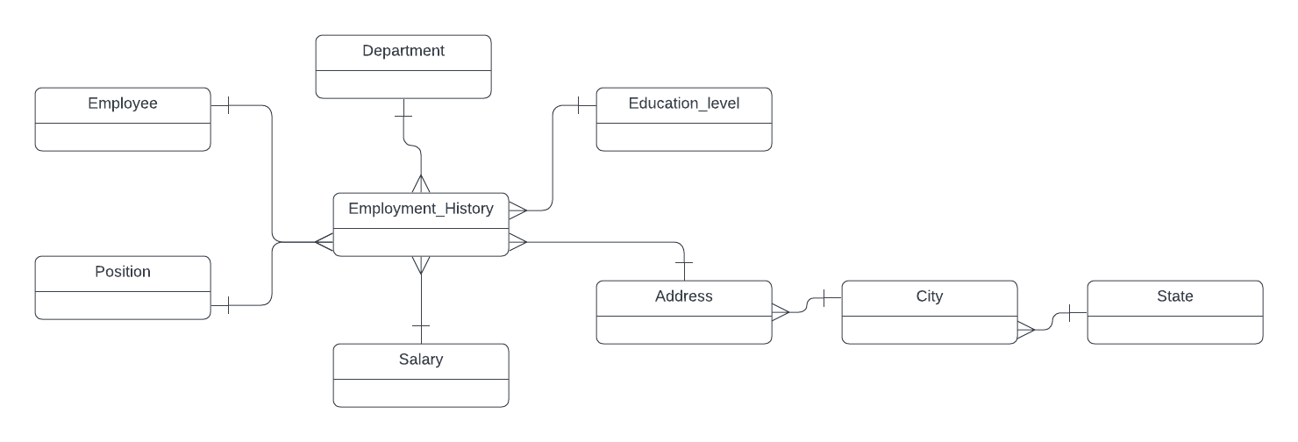
ERD
Conceptual Diagram

Slide 12
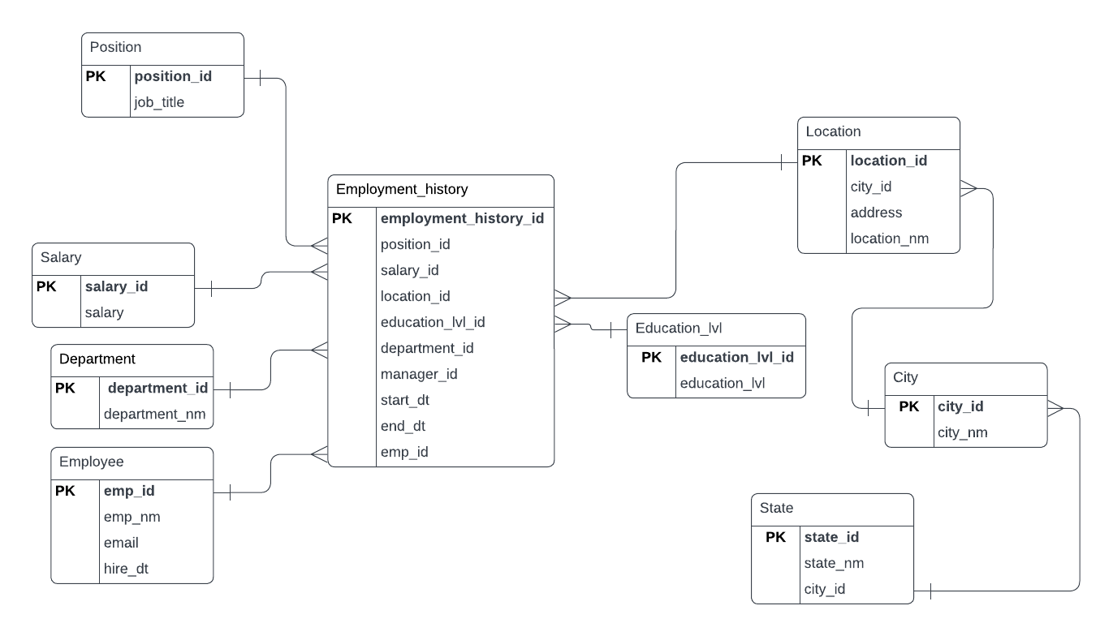
ERD
Logical
The logical model is the next level of refinement from the conceptual ERD. At this point, you should have normalized the data to the 3NF. Attributes should also be listed now in the ERD.

Slide 13
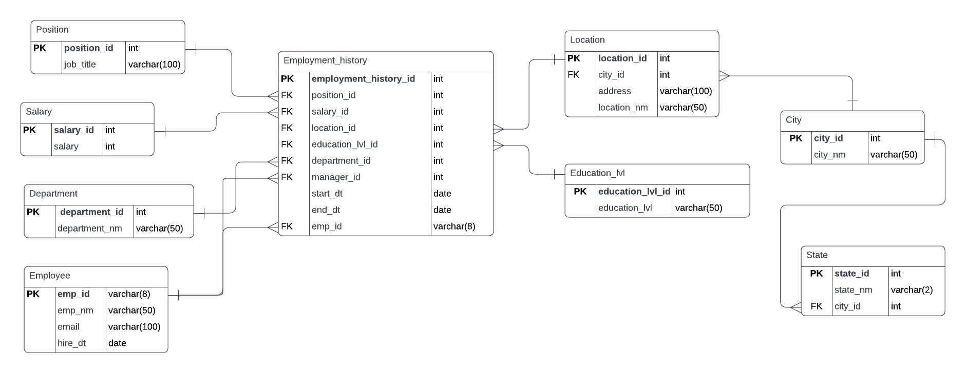
ERD
Physical
The physical model is what will be built in the database

Slide 14
Step 3
Create A Physical Database

Slide 15
Step 3: Create A Physical Database
In this step, you will be turning your database model into a physical database.
You will:
Create the database using SQL DDL commands
Load the data into your database, utilizing flat file ETL
Answer a series of questions using CRUD SQL commands to demonstrate your database was created and populated correctly
Submission
For this step, you will need to submit SQL files containing all DDL SQL scripts used to create the database.
You will also have to submit screenshots showing CRUD commands, along with results for each of the questions found in the starter template.
Hints
Your DDL script will be graded by running the code you submit. Please ensure your SQL code runs properly!
Foreign keys cannot be created on tables that do not exist yet, so it may be easier to create all tables in the database, then to go back and run modify statements on the tables to create foreign key constraints.
After running CRUD commands like update, insert, or delete, run a SELECT* command on the affected table, so the reviewer can see the results of the command.

Slide 16
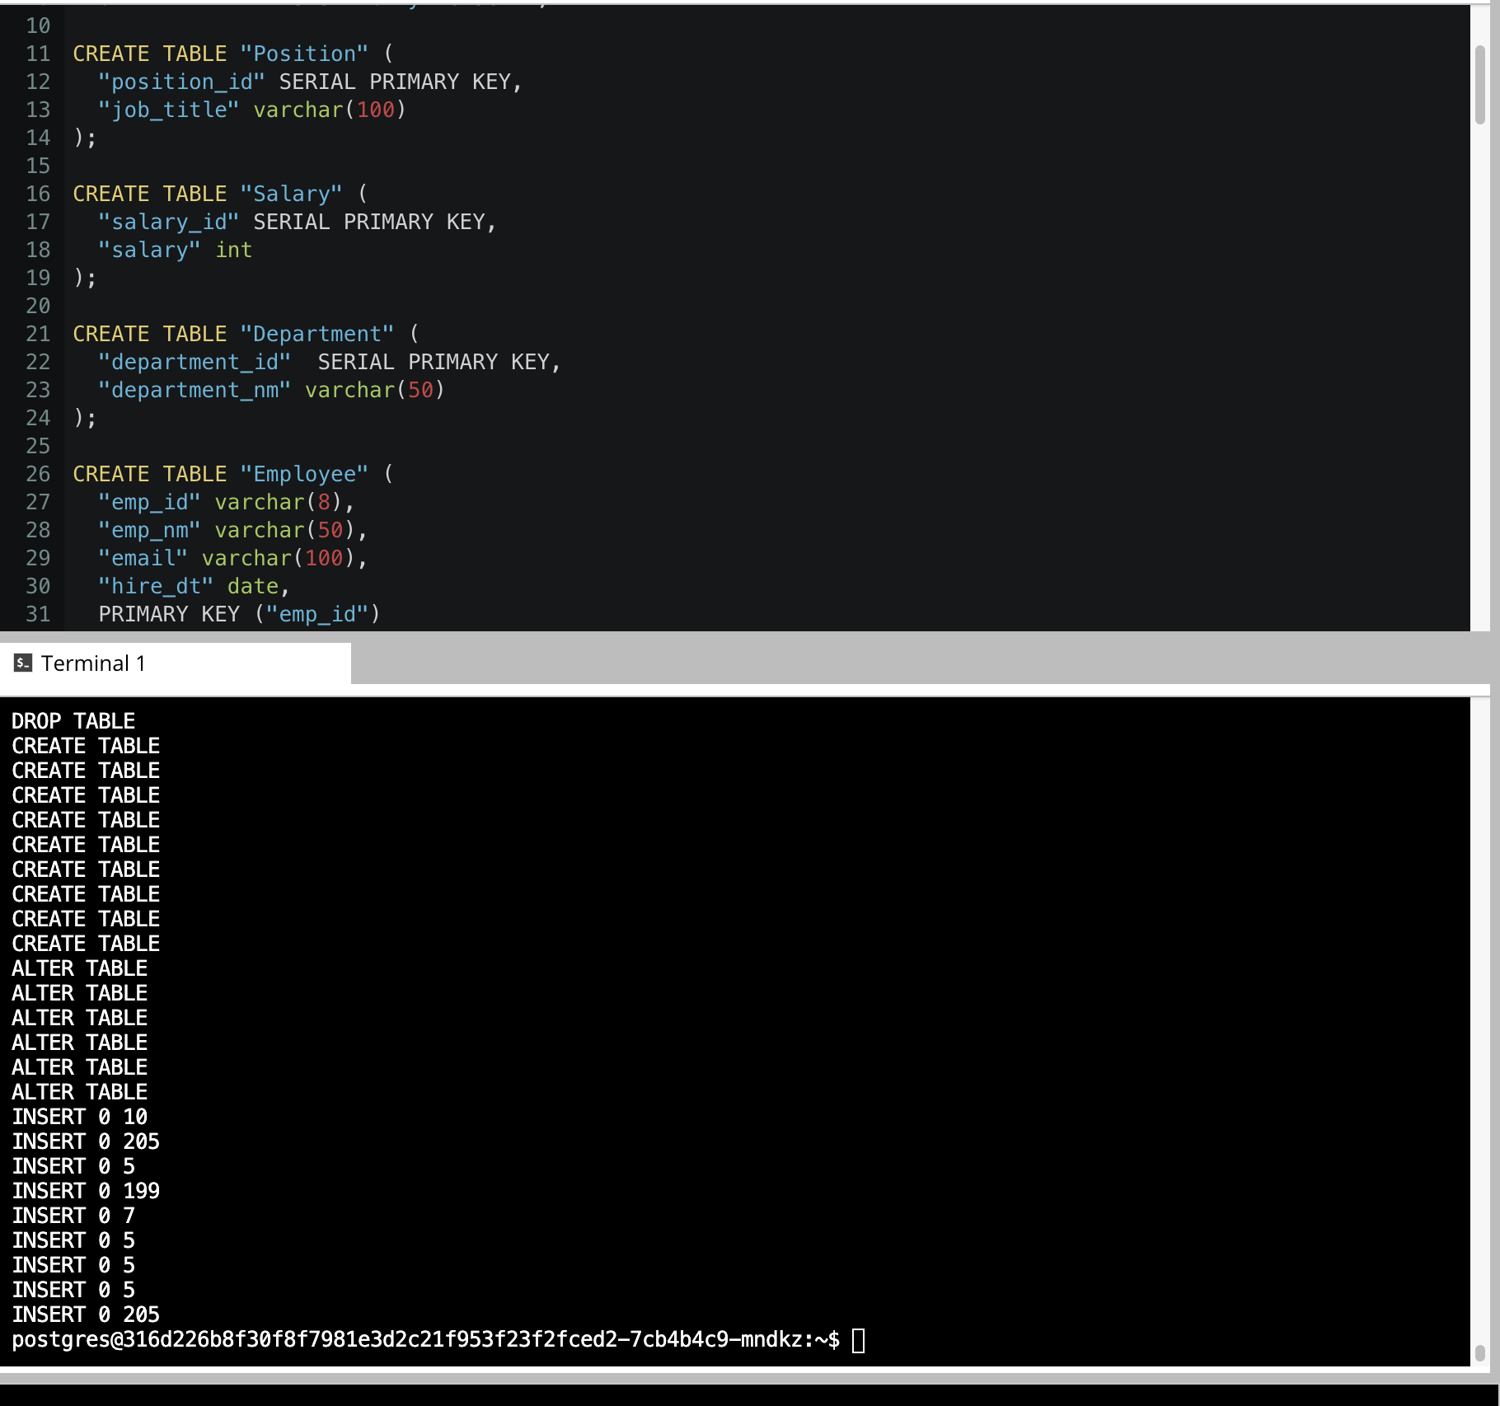
DDL
Create a DDL SQL script capable of building the database you designed in Step 2

Slide 17
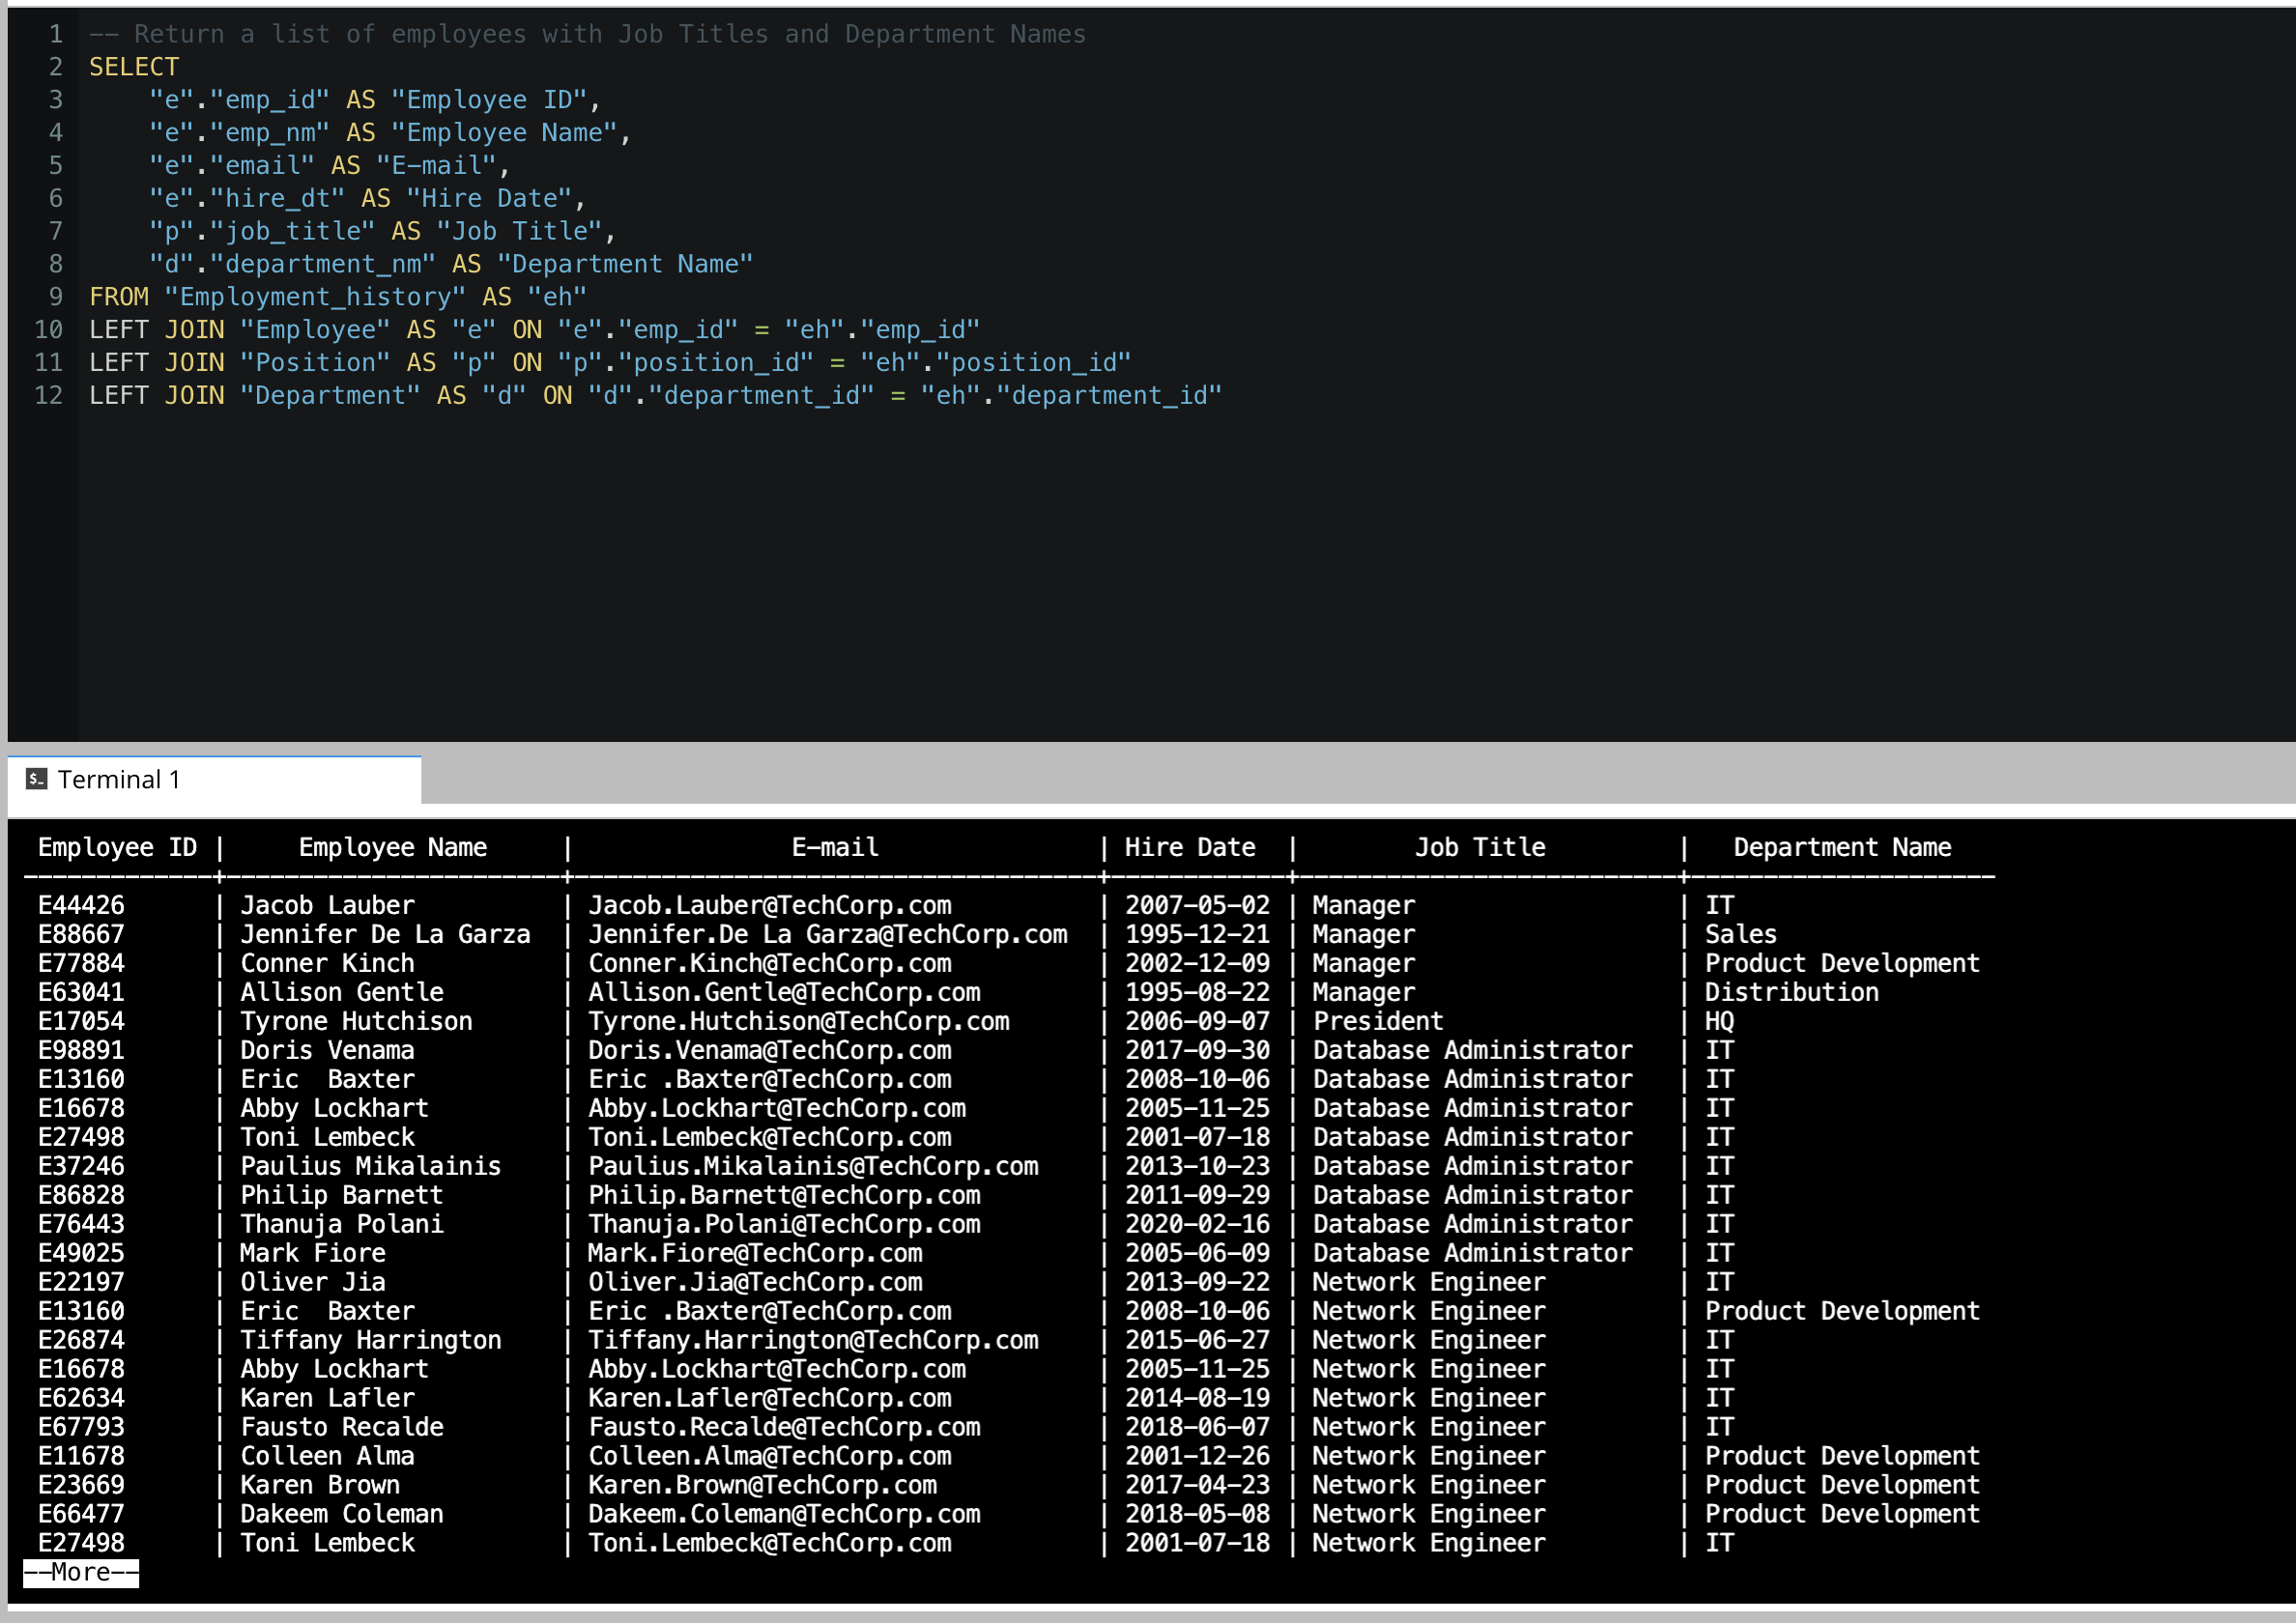
CRUD
Question 1: Return a list of employees with Job Titles and Department Names
** Replace example screenshot below with your response, and include the query in a SQL file

Slide 18
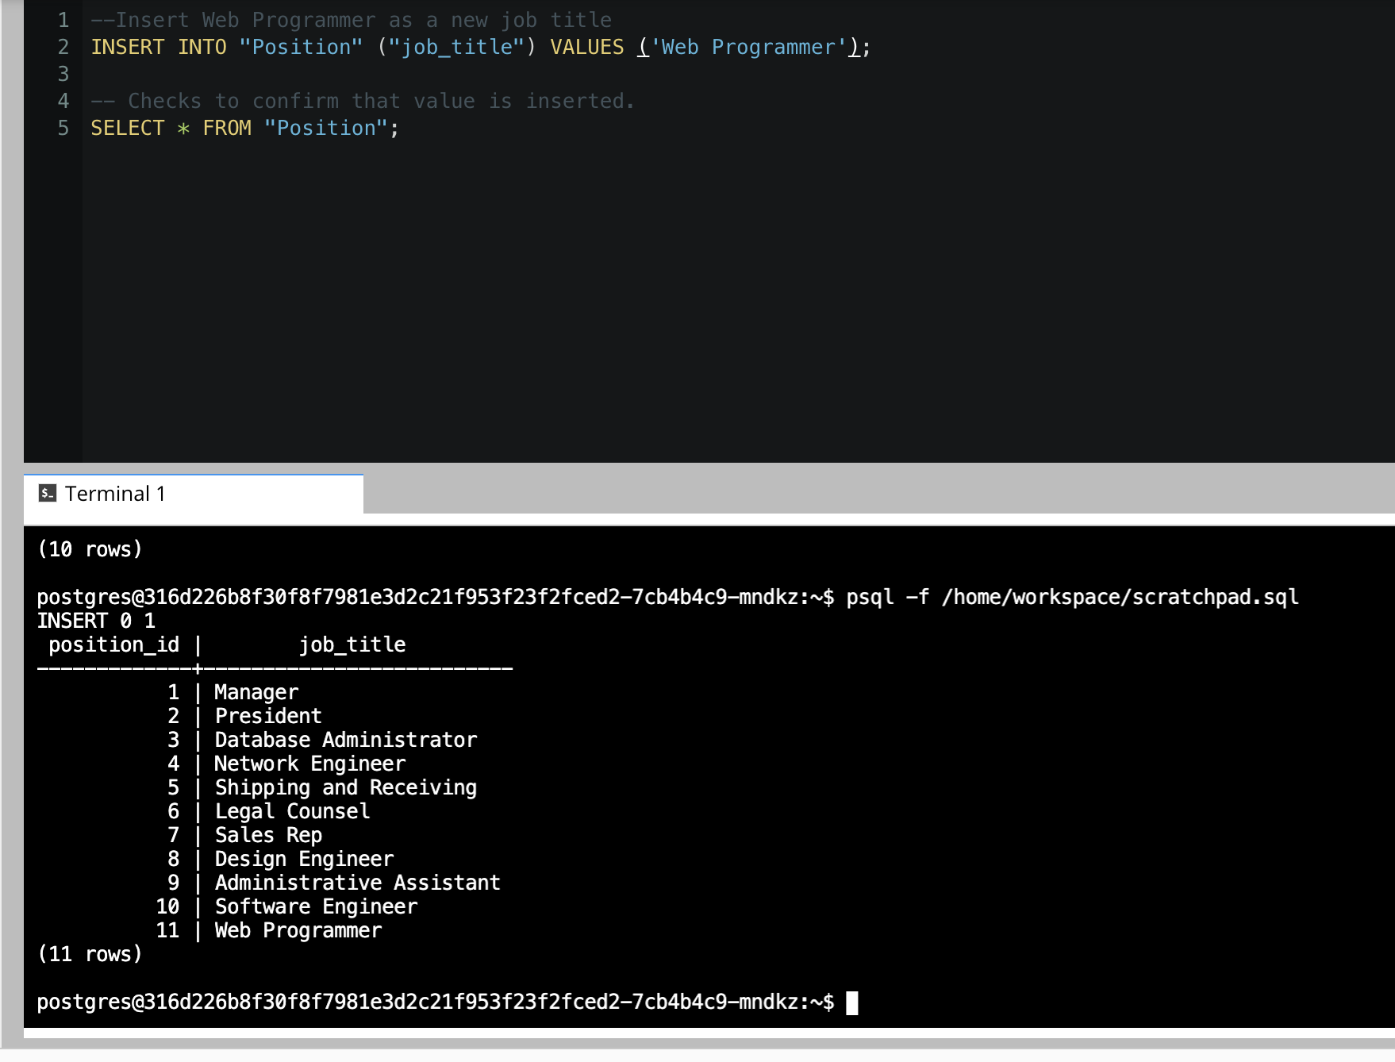
CRUD
Question 2: Insert Web Programmer as a new job title

Slide 19
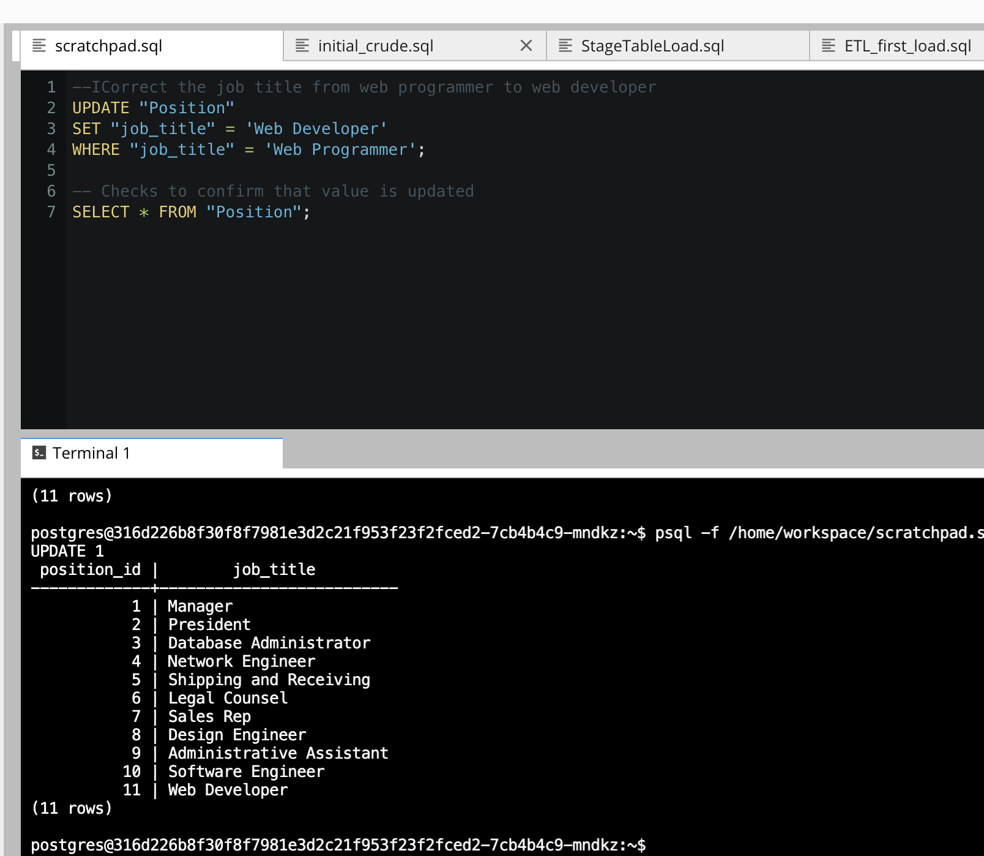
CRUD
Question 3: Correct the job title from web programmer to web developer

Slide 20
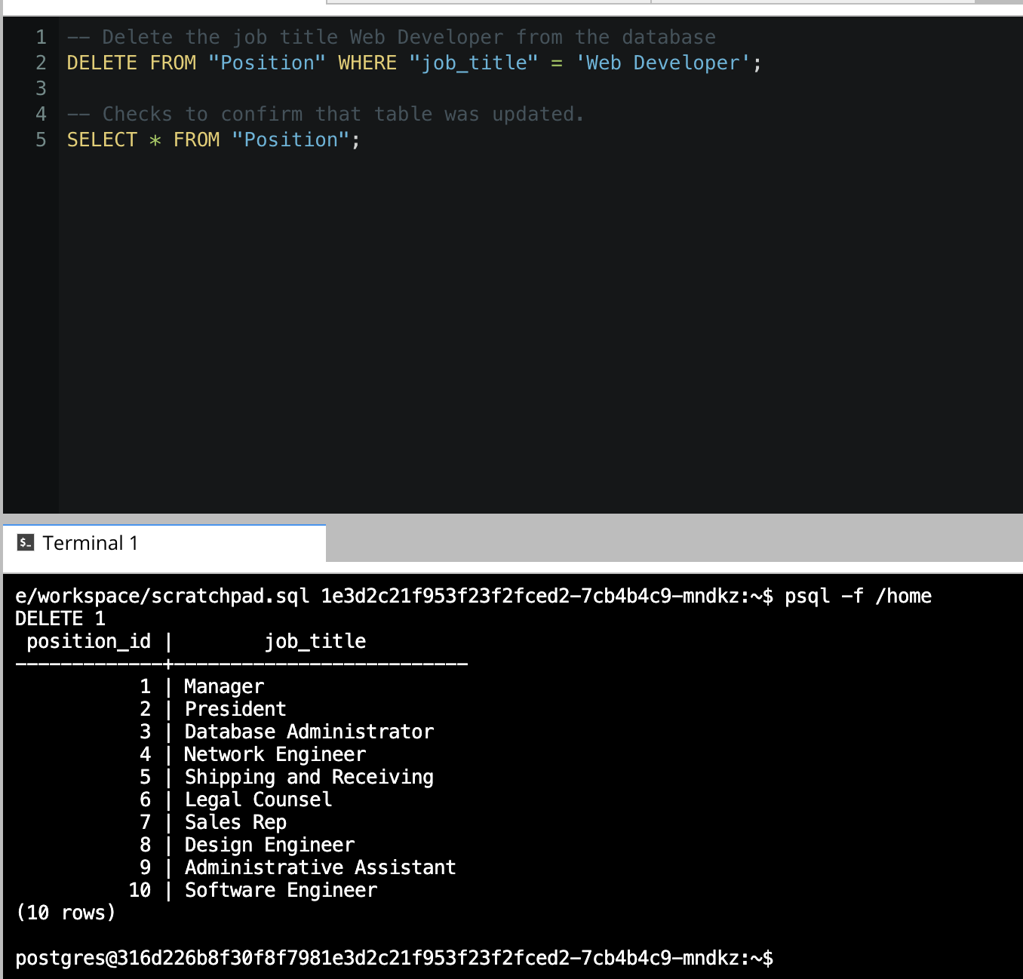
CRUD
- Question 4: Delete the job title Web Developer from the database

Slide 21
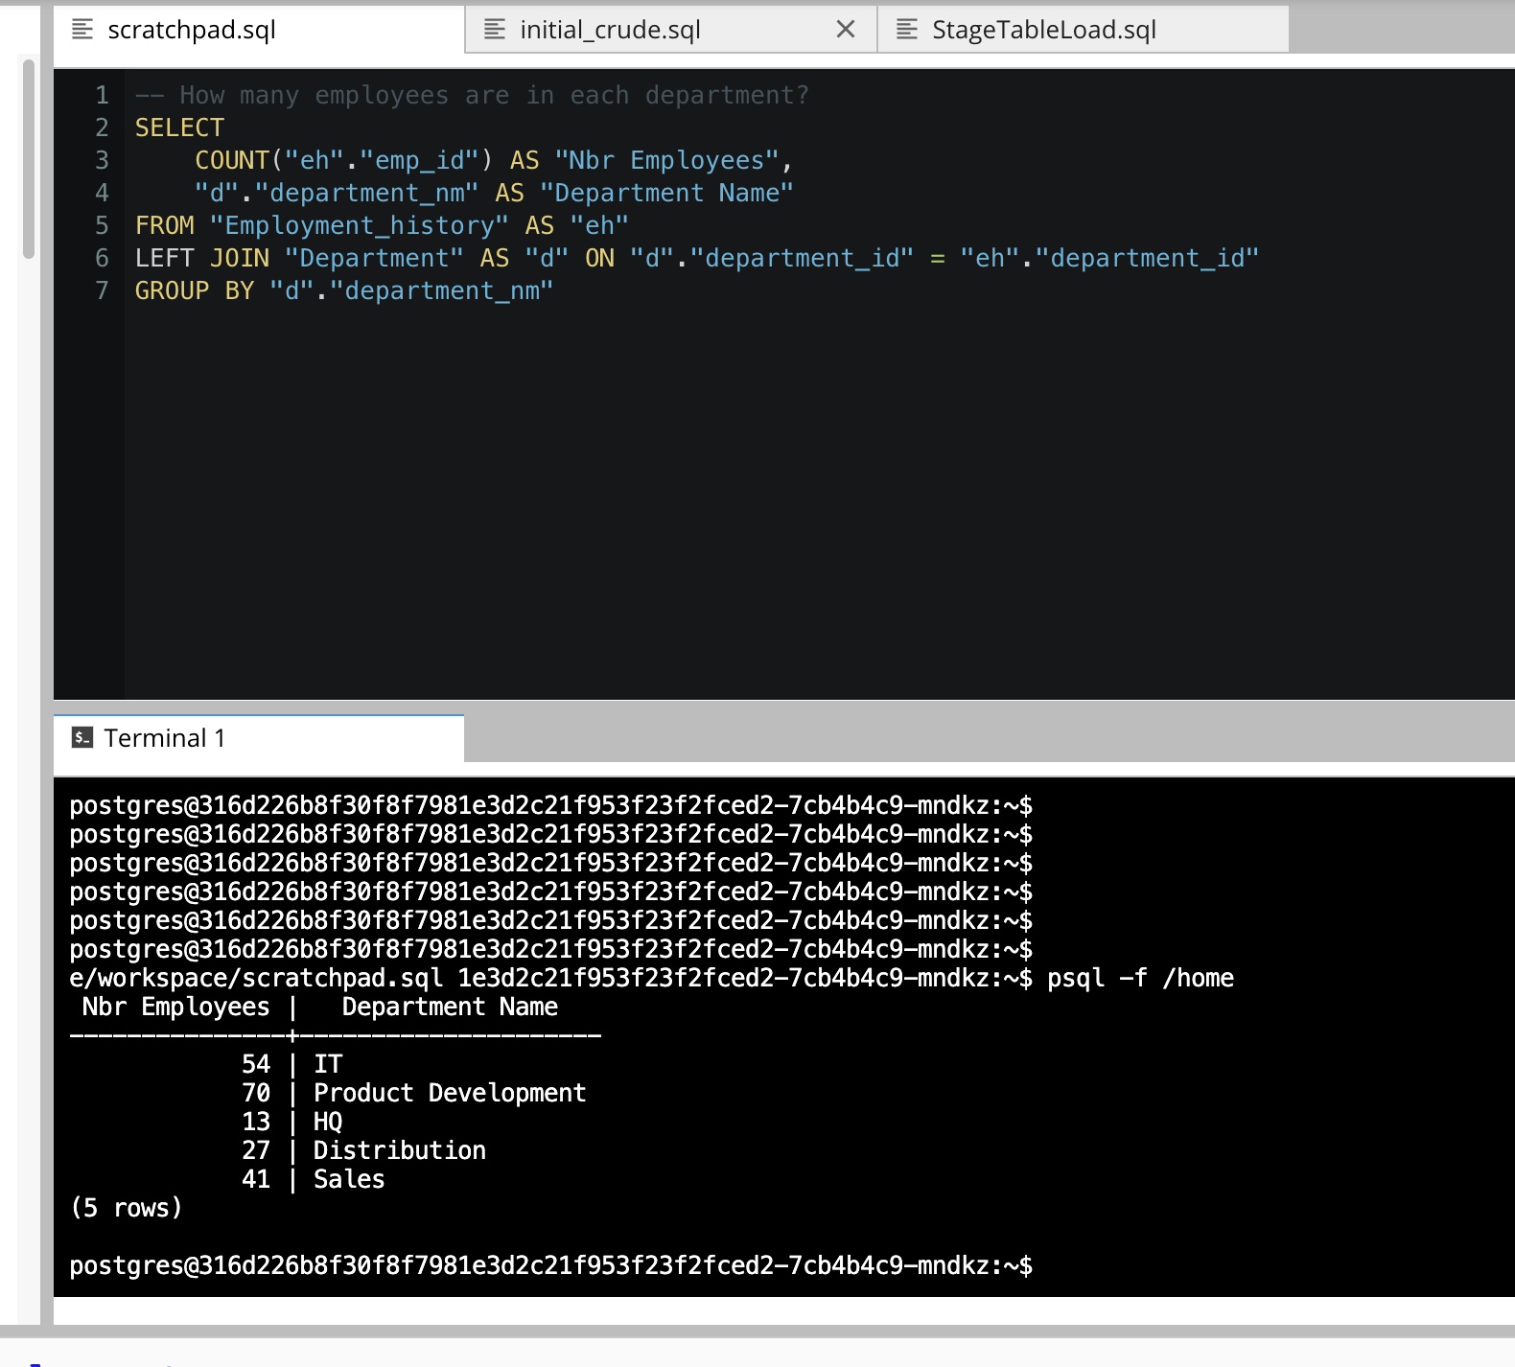
CRUD
Question 5: How many employees are in each department?

Slide 22
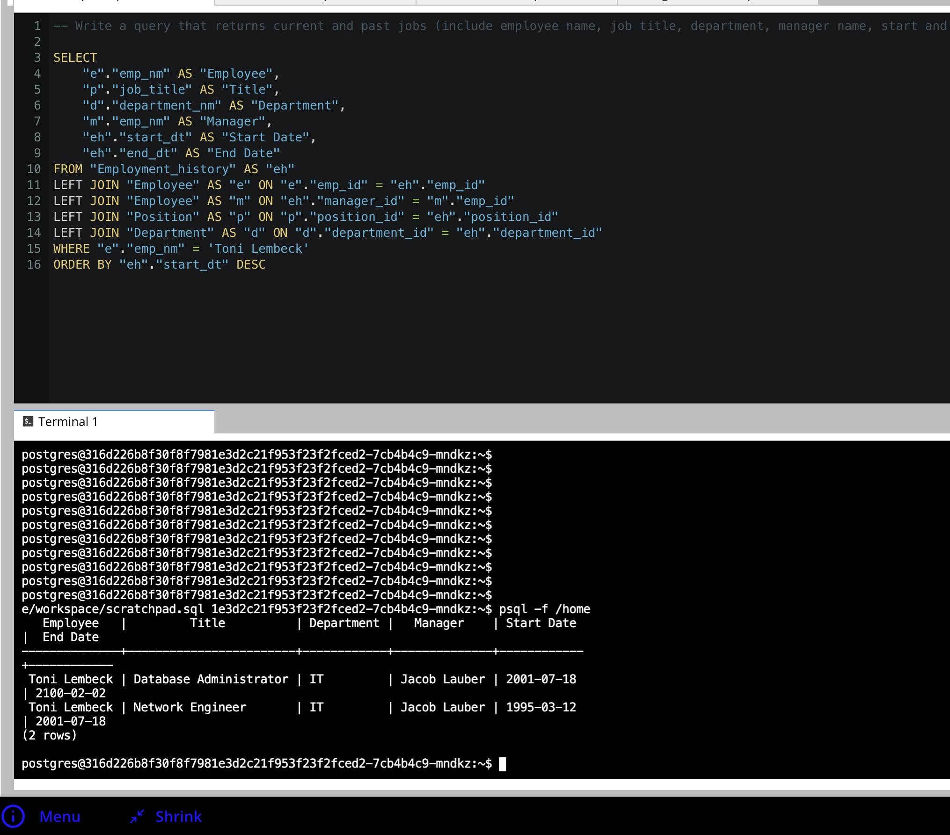
CRUD
Question 6: Write a query that returns current and past jobs (include employee name, job title, department, manager name, start and end date for position) for employee Toni Lembeck.

Slide 23
CRUD
Question 7: Describe how you would apply table security to restrict access to employee salaries using an SQL server.
I would apply a row level security rule that would enable only HR employees to have access to all the records from the table and the employee to have access to his salary information.

Slide 24
Step 4
Above and Beyond (optional)

Slide 25
Step 4: Above and Beyond
This last step is called Above and Beyond. In this step, I have proposed 3 challenges for you to complete, which are above and beyond the scope of the project. This is a chance to flex your coding muscles and show everyone how good you really are.
These challenge steps will bring your project even more in line with a real-world project, as these are the kind of “finishing touches” that will make your database more usable. Imagine building a car without air conditioning or turn signals. Sure, it will work, but who would want to drive it.
I encourage you to take on these challenges in this course and any future courses you take. I designed these challenges to be a challenge to your current abilities, but I ensured they are not an unattainable challenge. Remember, these challenges are completely optional - you can pass the project by doing none of them, or just some of them, but I encourage you to at least attempt them!

Slide 26
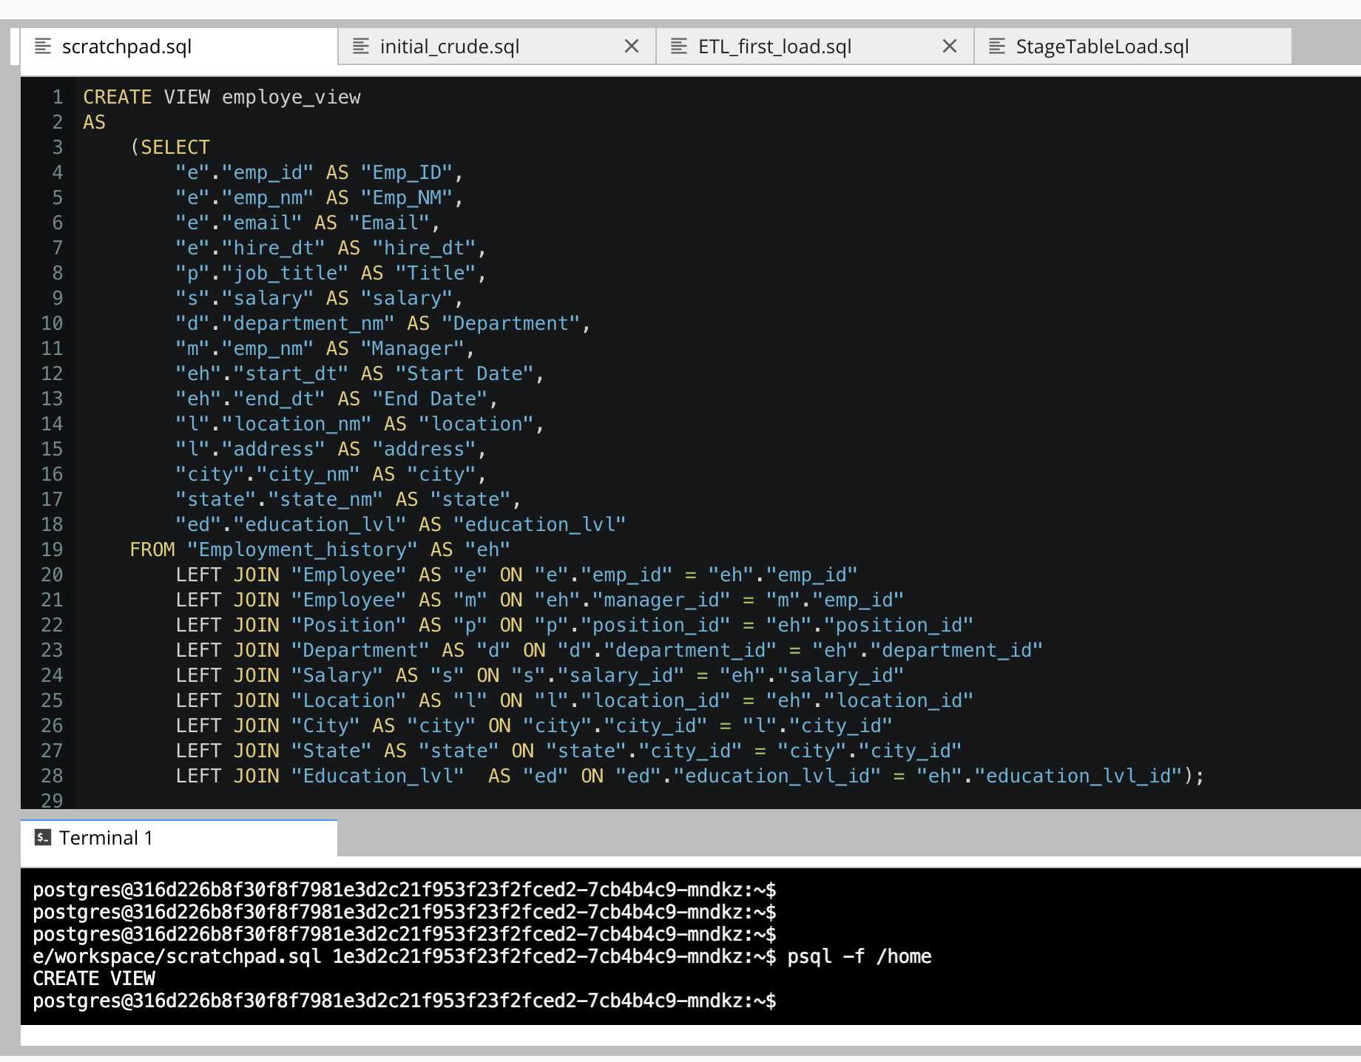
Standout Suggestion 1
Create a view that returns all employee attributes; results should resemble initial Excel file

Slide 27
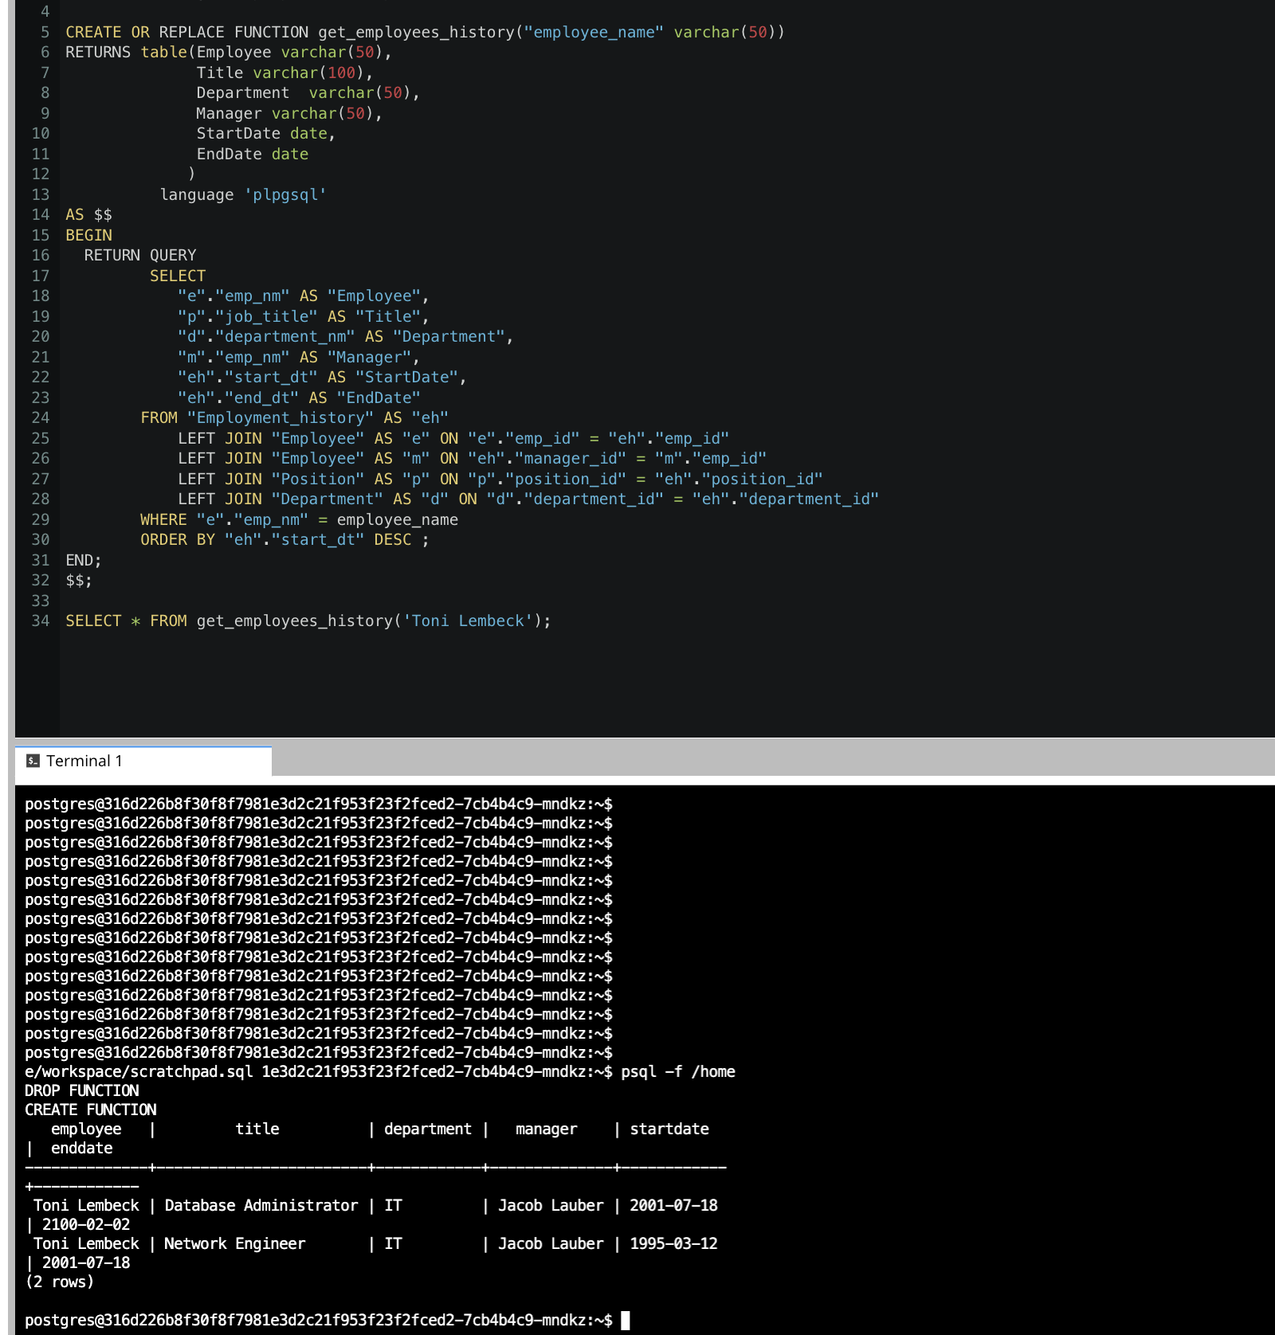
Standout Suggestion 2
Create a stored procedure with parameters that returns current and past jobs (include employee name, job title, department, manager name, start and end date for position) when given an employee name.

Slide 28
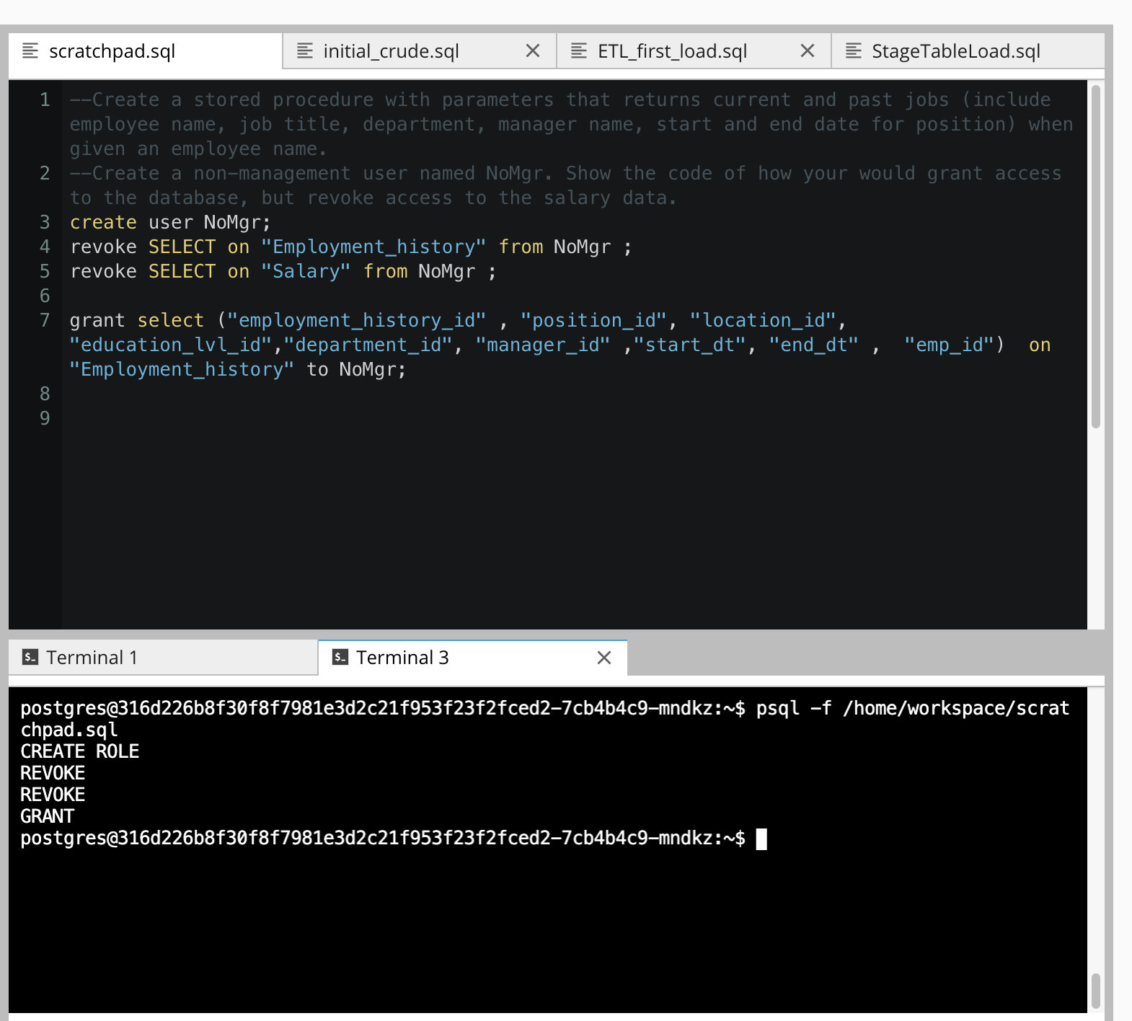
Standout Suggestion 3
Implement user security on the restricted salary attribute.

Slide 29
Appendix

Slide 30
Additional Info
You can include supporting or additional information that supports your previous slides, but isn’t necessary for every person to see that looks at your slides.

